Slide 1
Quick Ingest & Exploratory Data Analysis
The Foundation for Machine Learning on ATTEST Logs - Task-4

Slide 2
Objective:
Leverage historical execution patterns to automatically learn which test cases show recurring instability, anomaly behavior, or cluster-based failure trends.
Predict the likelihood of failure before execution, enabling proactive identification of risky scenarios across DUTs, suites, and configurations.
Rank and prioritize test cases intelligently so that high-risk tests run first, accelerating failure discovery and reducing overall regression cycle time.
Optimize resource allocation & execution sequencing by minimizing unnecessary runs of stable tests while emphasizing tests that contribute significant failure impact.
Provide actionable insights through visual analytics, enabling engineers to understand key failure drivers, feature importance, and improvement areas for test planning.

Slide 3
Input Data & Feature Engineering :
=> Used enriched historical datasets including classified logs, cluster labels, anomaly scores, and execution metadata from Tasks 1–3.
=> Merged multi-source information (logs, DUT details, suite data, timestamps) to build a unified historical profile for every test case.
=> Computed test-case behavioral features such as past failure rate, execution frequency, time since last failure, and average duration.
=> Added environment & DUT-related signals including DUT type/version, suite configuration, regression group, and schedule cycle.
=> Extracted failure-specific insights such as cluster severity, error keywords, anomaly scores, and classifier confidence.
=> Constructed a complete ML feature matrix combining numeric + categorical indicators to predict next-run failure probability.

Slide 4
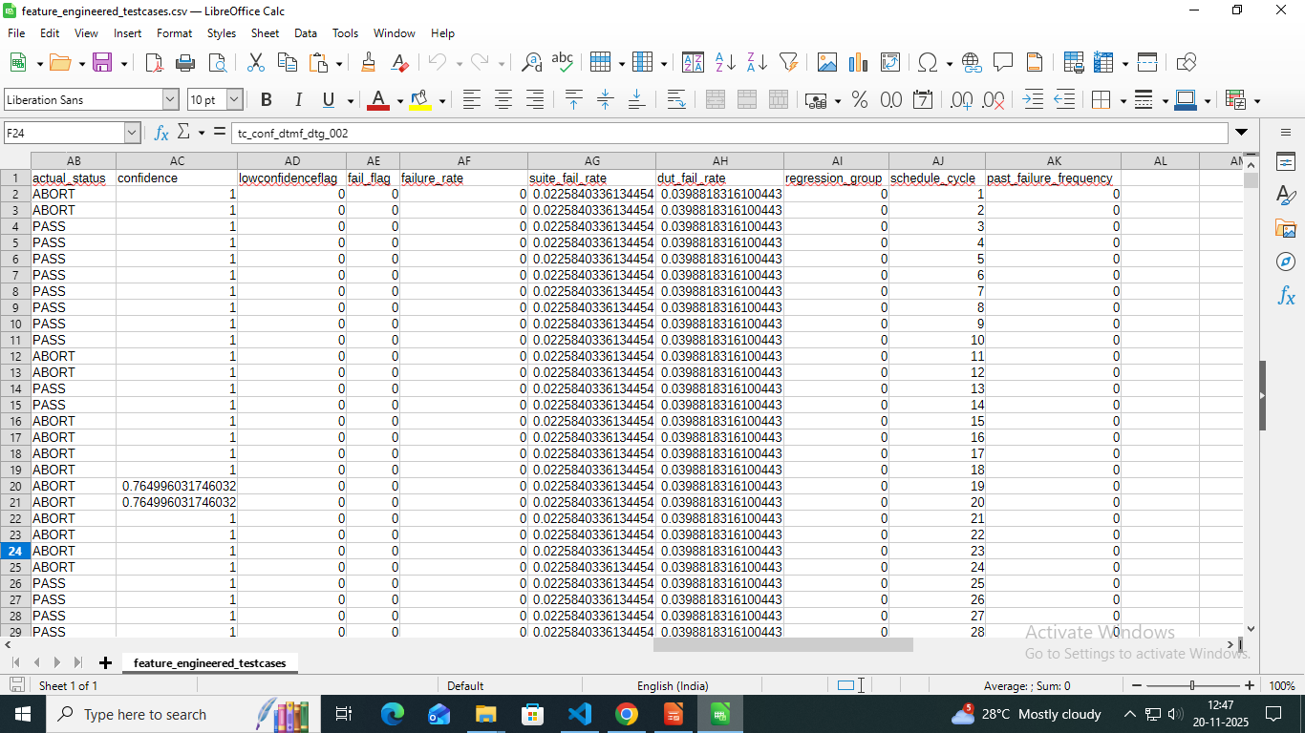
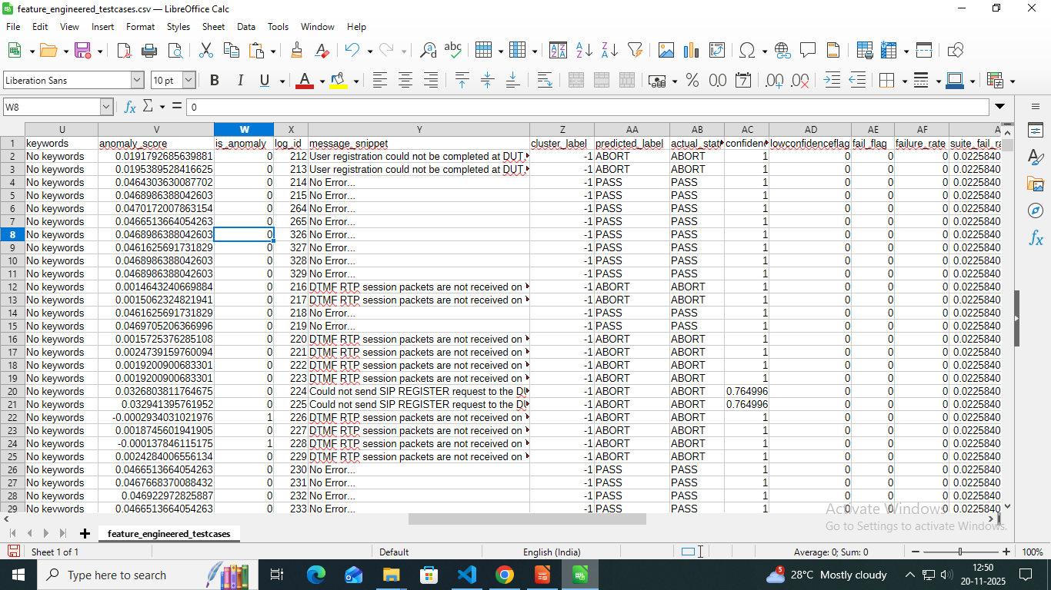

Slide 5
ML Model Training (XGBoost) :
Selected XGBoost as the final model for its strong performance on tabular, heterogeneous test-execution data (numeric + categorical + engineered features).
Trained on enriched historical logs combining cluster labels, anomaly signals, classifier outputs, execution metadata, and test-case behavior features.
Automatically learned complex interactions such as: “recent failures + high anomaly score + certain DUT versions ⇒ high risk of failure.”
Tuned key hyperparameters (max_depth, learning_rate, n_estimators) to optimize Top-K failure capture, not just overall accuracy.
The trained model outputs a continuous failure probability for every test case, enabling dynamic prioritization before the next execution cycle.

Slide 6
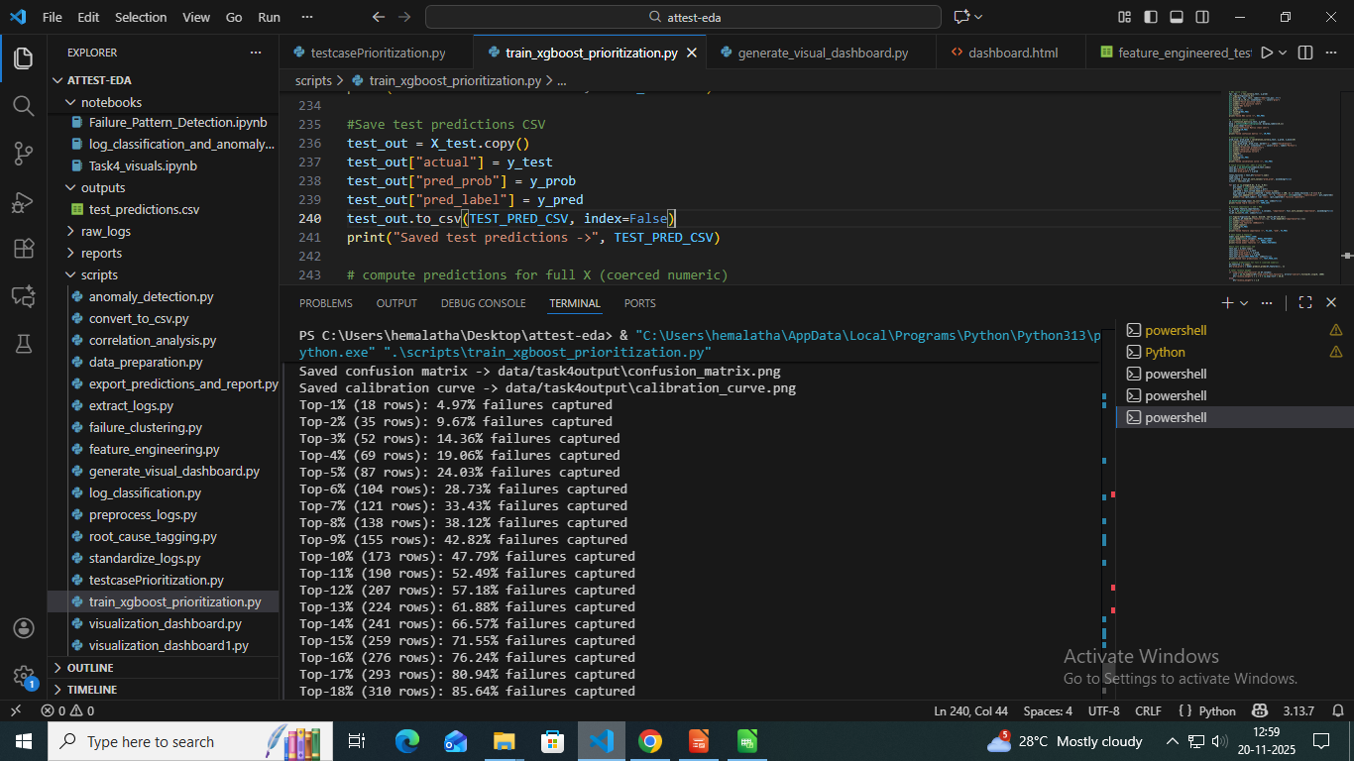
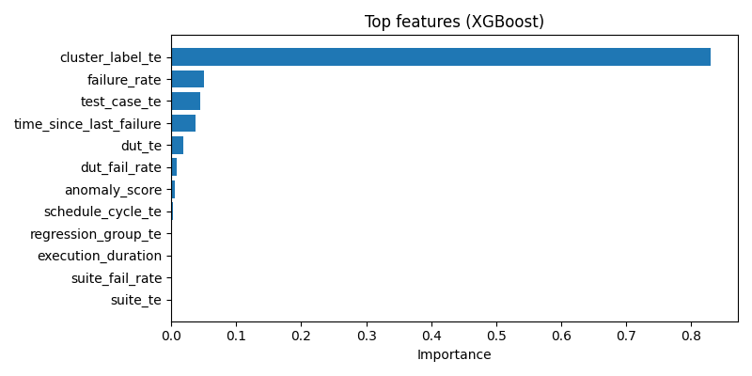
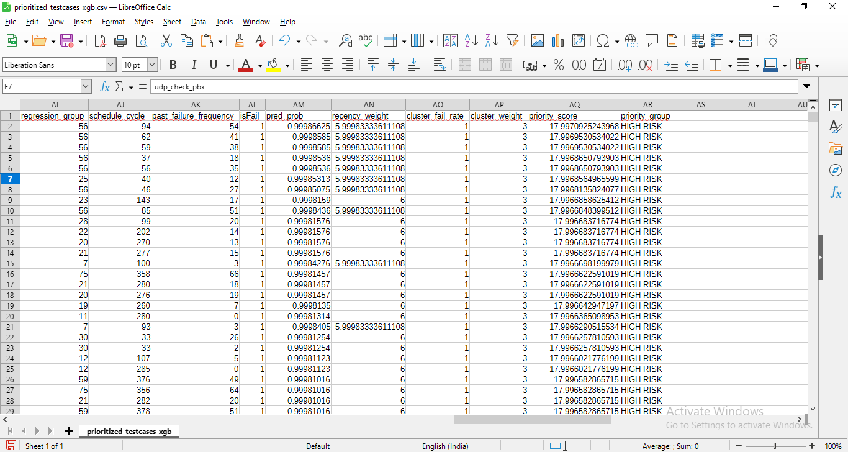

Slide 7
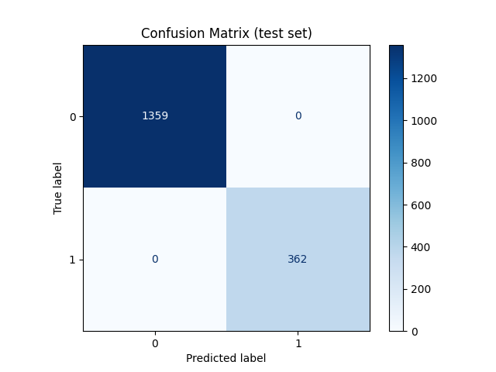
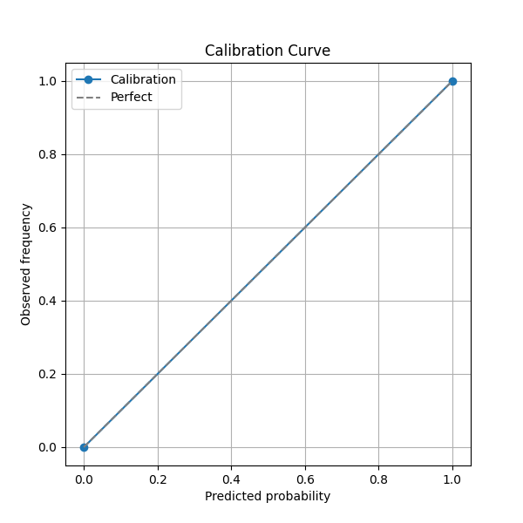
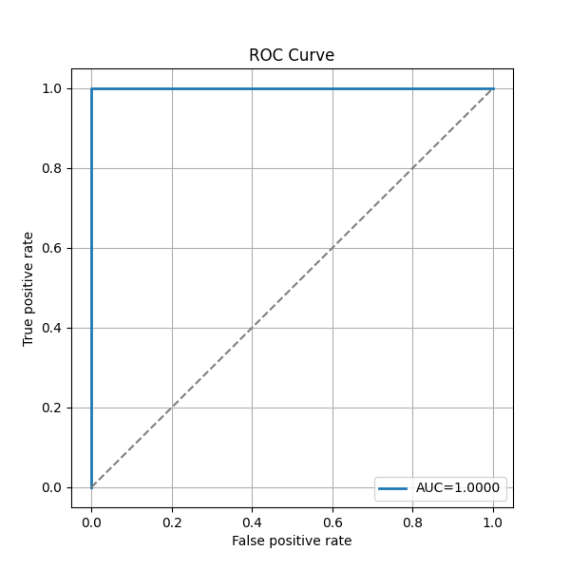
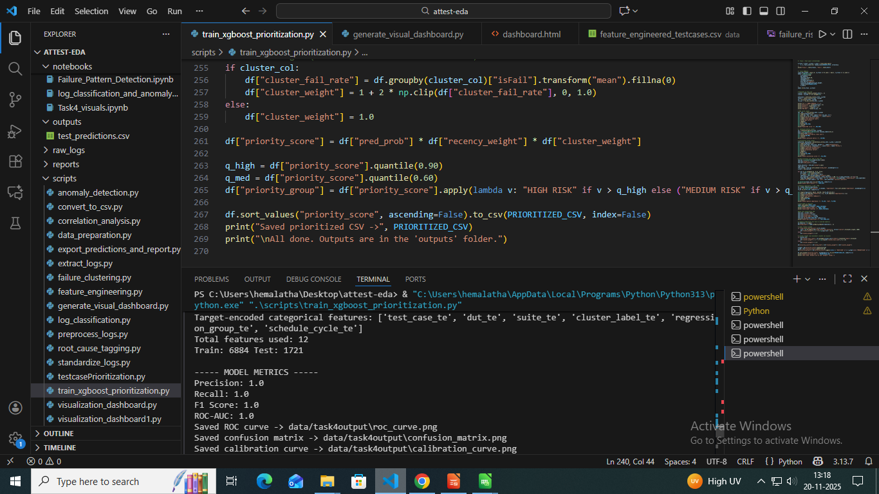
Model Evaluation Metrics:
Confusion Matrix to compare predicted vs actual failures.
Precision, Recall, F1-score to measure classifier quality.
ROC–AUC curve to evaluate probability separation.
Calibration curve to verify prediction reliability.
Top-K accuracy: “Top 20 tests capture X% of failures.”

Slide 8
Prioritization Logic:
Prioritization Logic :
=> Priority Score Formula: Failure Probability × Cluster Severity × Recent Failure Weight.
=> Failure probability comes from the ML model predicting how likely a test is to fail.
=> Cluster severity boosts priority for tests belonging to high-impact failure clusters.
=> Recent failure weight increases scores for tests that failed in the latest cycles.
=> Risk Bucketing:
Tests are classified into High , Medium , Low risk groups to decide execution order.

Slide 9
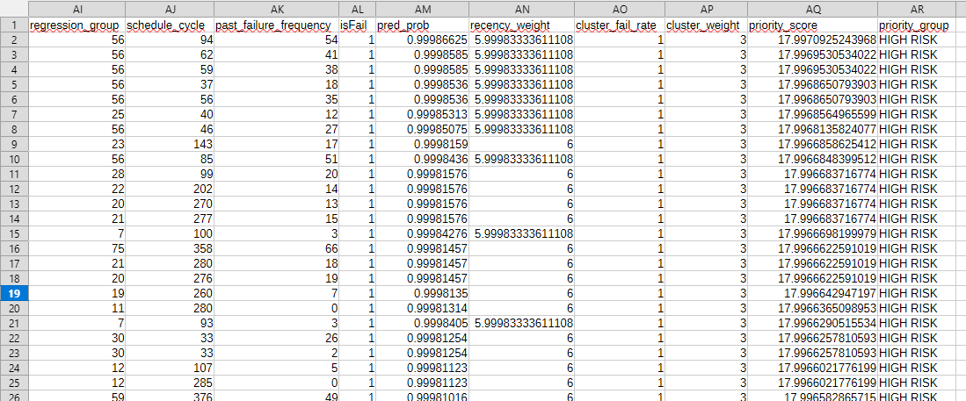
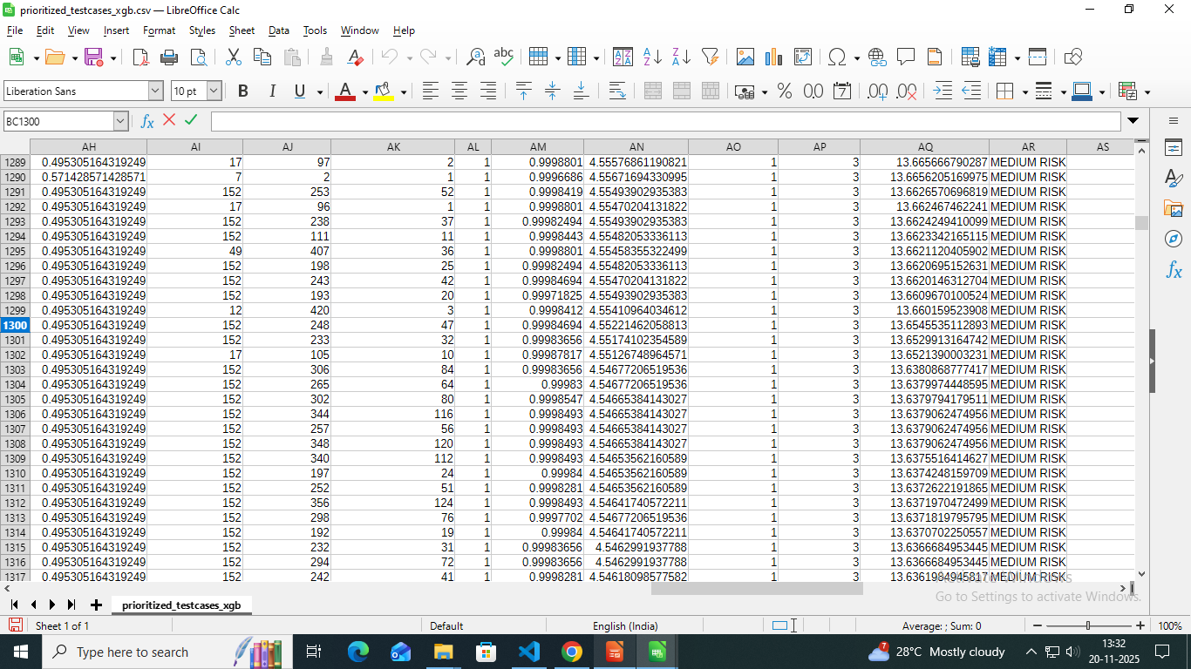
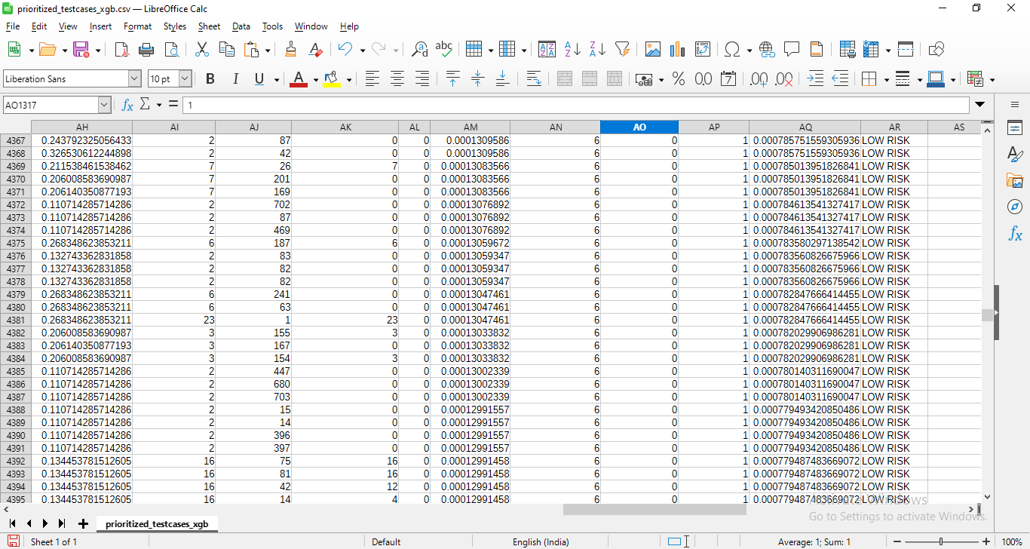

Slide 10
Visualization Dashboard:
=> Failure Risk Heatmap: Shows risk levels across Test Case × DUT, helping identify devices or modules with consistently high failure probability.
=> Probability Distribution Curve: Displays how failure probabilities are spread across all test cases, highlighting clusters of high-risk tests.
=> Top 10 High-Risk Tests (Bar Chart): Ranks the most failure-prone test cases, enabling quick selection for early execution.
=> Suite-Wise Failure Trend Line: Tracks how failure behaviour changes across multiple execution cycles, revealing unstable suites.
=> Feature Importance Plot (XGBoost): Explains which engineered features most influence the failure prediction, improving model transparency.

Slide 11
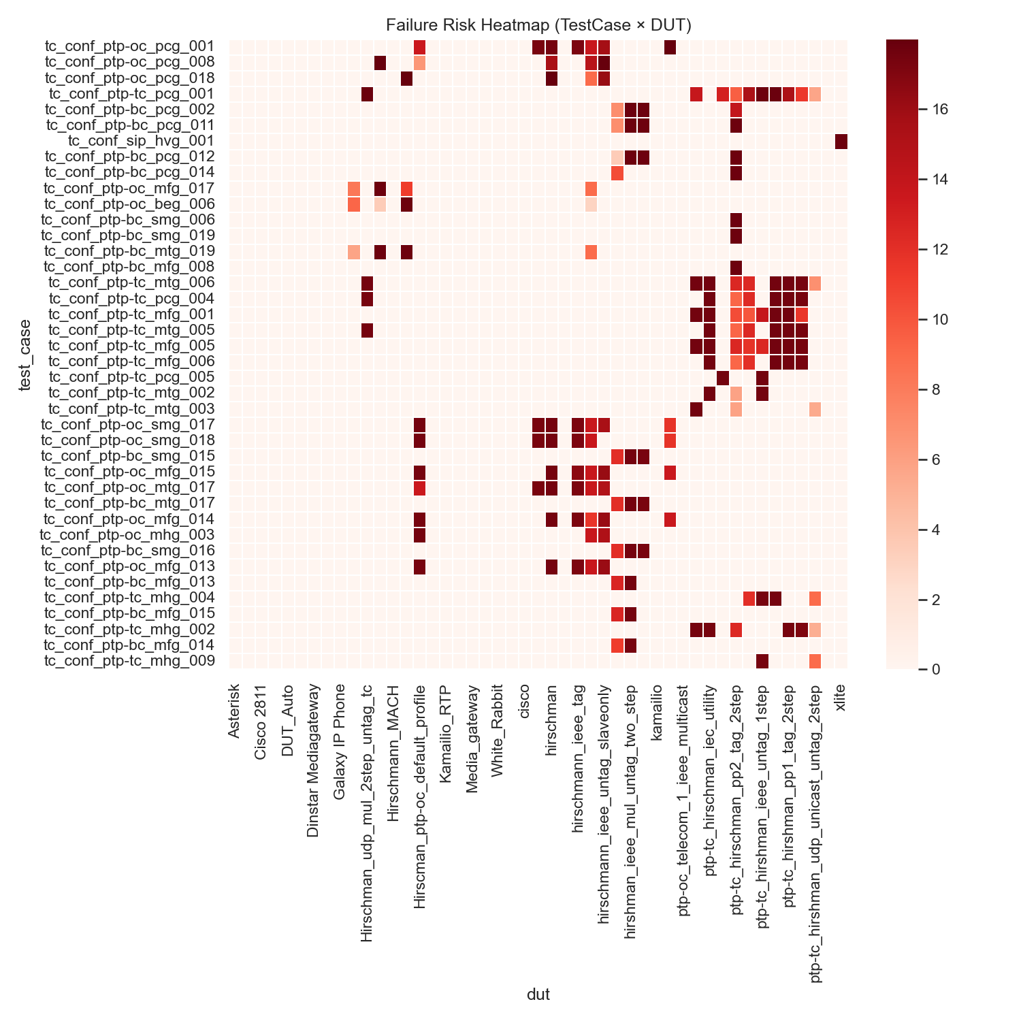
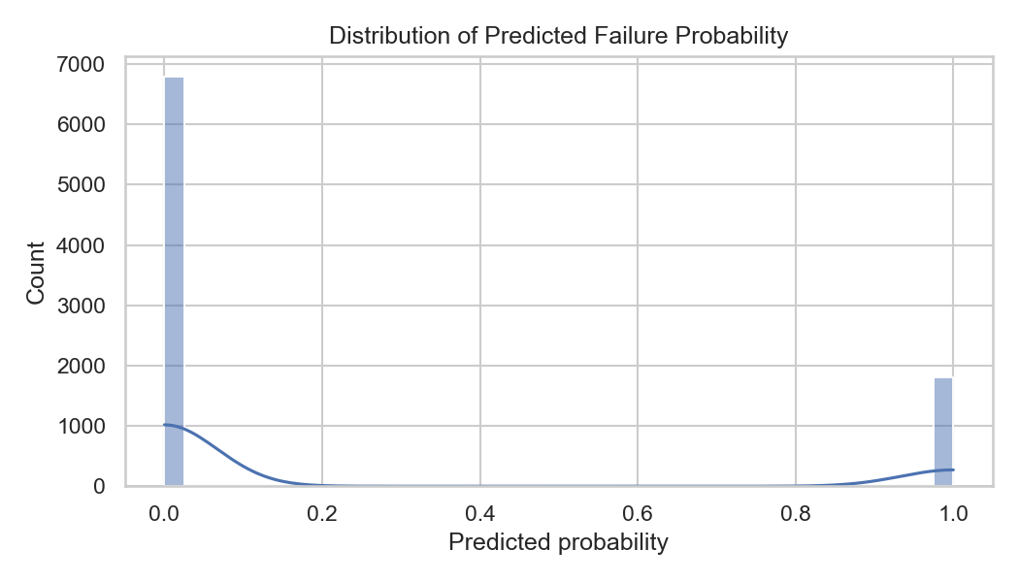
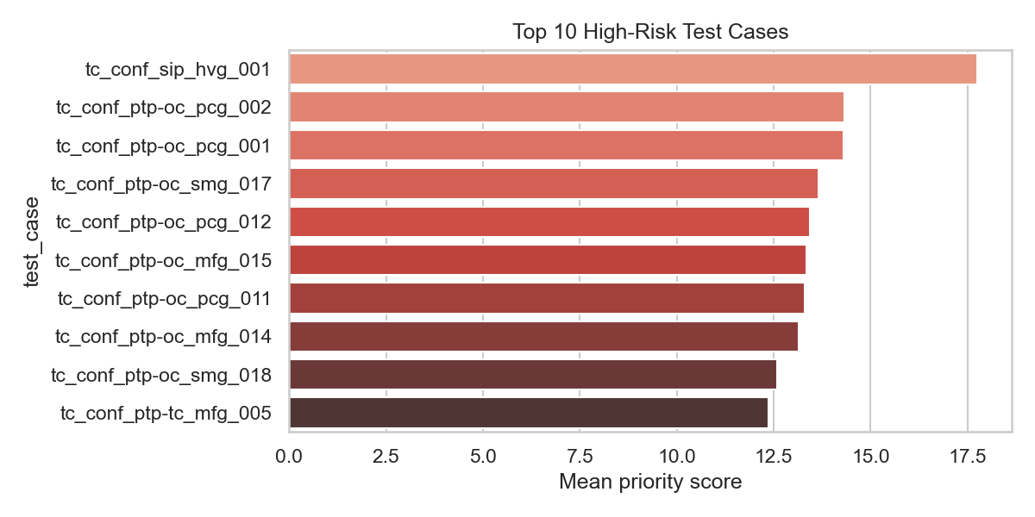

Slide 12
Thank You

